Slide 1

Terraform
B
Y
K
U
M
A
R
B
Y
K
U
M
A
R

Slide 2
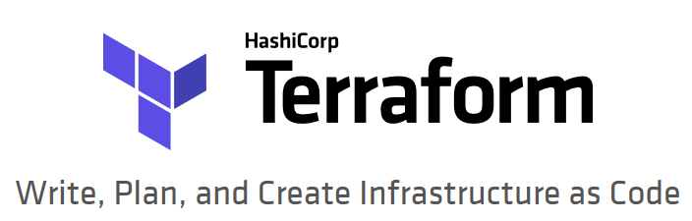
What is Terraform?
Terraform is a tool for building, changing, and versioning infrastructure safely and efficiently. Terraform can manage existing and popular service providers as well as custom in-house solutions.
Notes:
https://www.terraform.io/intro/index.html

Slide 3
The key features of Terraform
Infrastructure as a Code
Execution Plans
Resource Graph
Change Automation
Notes:
https://www.terraform.io/intro/index.html
Infrastructure as Code
Infrastructure is described using a high-level configuration syntax. This allows a blueprint of your datacenter to be versioned and treated as you would any other code. Additionally, infrastructure can be shared and re-used.
» Execution Plans
Terraform has a "planning" step where it generates an execution plan. The execution plan shows what Terraform will do when you call apply. This lets you avoid any surprises when Terraform manipulates infrastructure.
» Resource Graph
Terraform builds a graph of all your resources, and parallelizes the creation and modification of any non-dependent resources. Because of this, Terraform builds infrastructure as efficiently as possible, and operators get insight into dependencies in their infrastructure.
» Change Automation
Complex changesets can be applied to your infrastructure with minimal human interaction. With the previously mentioned execution plan and resource graph, you know exactly what Terraform will change and in what order, avoiding many possible human errors.

Slide 4
Why Terrafomr?
Azure and Terrafomr partnership https://docs.microsoft.com/en-us/azure/developer/terraform/
Terraform template define in declarative approach, immutable
Terraform maintain local/remote state
Terraform work in onprem or any cloud
Notes:
https://docs.microsoft.com/en-us/azure/developer/terraform/
https://docs.microsoft.com/en-us/azure/developer/terraform/overview

Slide 5
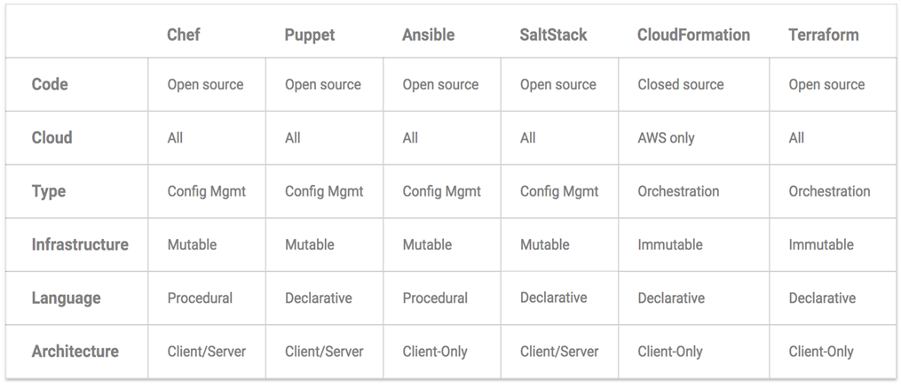
Terrafomr Vs Others
Notes:
https://blog.gruntwork.io/why-we-use-terraform-and-not-chef-puppet-ansible-saltstack-or-cloudformation-7989dad2865c

Slide 6
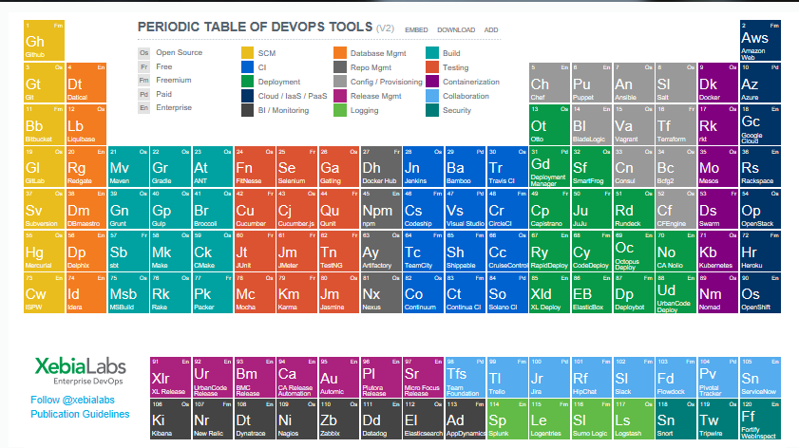
Terrafomr in XebiaLabs

Slide 7
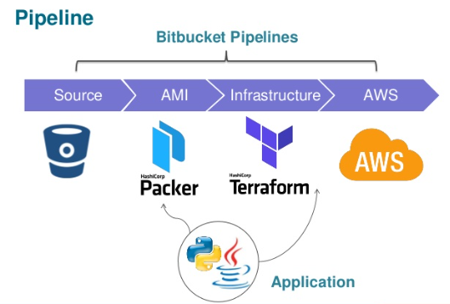
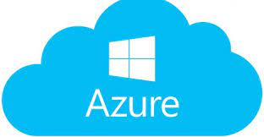
Terraform will paly vital roles for infra. provisioning

Slide 8
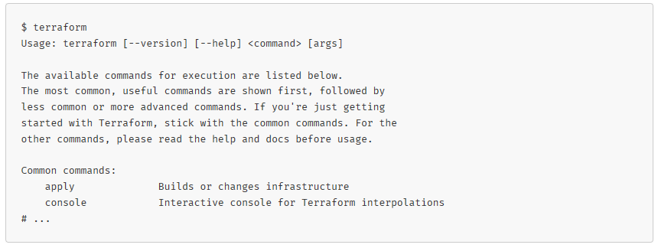
Verifying the Installation

Slide 9
Terraform Common commands
apply Builds or changes infrastructure
console Interactive console for Terraform interpolations
destroy Destroy Terraform-managed infrastructure
env Workspace management
fmt Rewrites config files to canonical format
get Download and install modules for the configuration
graph Create a visual graph of Terraform resources
import Import existing infrastructure into Terraform
init Initialize a Terraform working directory
output Read an output from a state file
plan Generate and show an execution plan

Slide 10
Terraform Common commands
providers Prints a tree of the providers used in the configuration
push Upload this Terraform module to Atlas to run
refresh Update local state file against real resources
show Inspect Terraform state or plan
taint Manually mark a resource for recreation
untaint Manually unmark a resource as tainted
validate Validates the Terraform files
version Prints the Terraform version
workspace Workspace management
All other commands:
debug Debug output management (experimental)
force-unlock Manually unlock the terraform state
state Advanced state management

Slide 11
example.tf
provider "azurerm" {
version = "2.12.0"
features {}
}
resource "azurerm_resource_group" "demo" {
name = "resource-group-demo1"
location = var.location
tags = {
env = "resource-group-demo1888"
}
}
variable "location" {
type = string
default = "westeurope“
}

Slide 12
Folder: DayLearningTerraform
subFolder
app.tf
main.tf
subFolder
Supportingfile.txt
main.tf

